Slide 1
DDOS Attack Detection And Mitigation Using Statistical and Machine learning Methods In SDN
NAME:- Vishal Kumar Singh
X18201687
Click Here to open the OneDrive Project video

Slide 2
Research Question
“Can Software defined networking improve the detection and mitigation of DDOS attacks in a cloud environment”

Slide 3
Methodology
Statistical Analysis of traffic Features
Speed of IP sources
Flowcount
Speed of flow entries
Ratio of pair-flow entries
Machine learning method
Support vector machine-Used For Evaluation
Decision tree

Slide 4
Methodology
Data Collection of the statistical features.
Normal traffic
Attack traffic
SVM will be using this dataset to train itself and to predict the traffic as normal or DDOS attack traffic.

Slide 5


Development tools
Platform setup on virtual machine with Ubuntu 20.04 OS
OpenFlow Protocol for SDN
Ryu controller – Python Based

Slide 6



Simulation tools
Mininet
Hping3
Iperf

Slide 7
Demonstration of the project
OneDrive Video Link-
https://studentncirl-my.sharepoint.com/:v:/g/personal/x18201687_student_ncirl_ie/EXOe698taxNFlZljcpfPaEEBl8jAlhyWpxEQGeMP9_VmnQ?e=qd1ujN

Slide 8
Evaluated Results

Slide 9
Evaluated Results

Slide 10
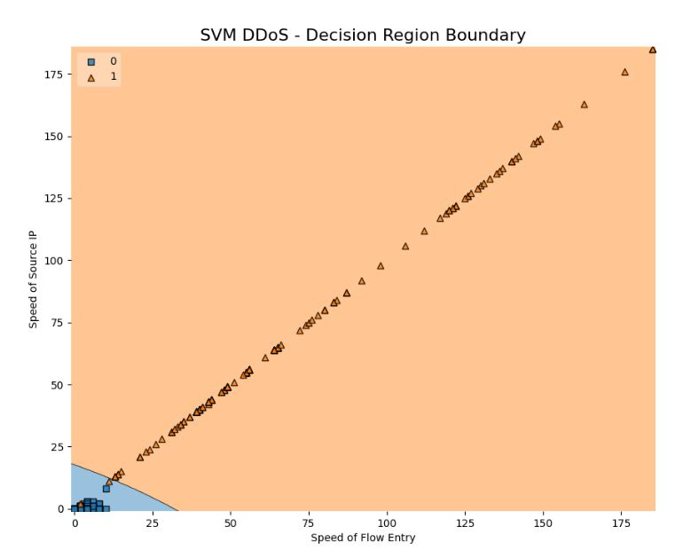
SVM Prediction Graph

Slide 11
Limitation of this method
Faulty dataset trained to the SVM
Trusted IP can be used to attack the network which the SVM would not detect.

Slide 12
Future Work
Multiple controller and switches network topology
More parameters defined and features extracted from the network
Deployment in real time network traffic.

Slide 13

Thank You

